Slide 1
Customer Churn Analysis
A simple study to understand why customers leave and how businesses can reduce churn
BY:
FALAK MUNIR AHMED TANGA
20241CSD0098
4CSD02

Slide 2
Problem Statement:
Customer churn occurs when customers discontinue using a company’s services. A high churn rate negatively affects business growth because acquiring new customers costs more than retaining existing ones.
To reduce churn, companies must identify which customers are leaving and why.
This analysis uses a Telco customer dataset containing demographic details, service usage, and account information. By studying churn patterns, the goal is to identify high-risk customer segments and derive insights that can help improve customer retention strategies.
Churn analysis helps companies stay competitive

Slide 3
Objectives of the Study
The main goals of this analysis are:
To study customer behavior using data
To identify customers who are more likely to churn
To understand how factors like contract type, tenure, and charges affect churn
To help businesses reduce churn using insights

Slide 4
Dataset Description:
The dataset used is the Telco Customer Churn dataset
It contains details of customers from a telecom company
Each row represents one individual customer
The dataset includes:
  Customer demographic information
  Service usage details
  Billing and payment-related data
The main focus of the dataset is the Churn variable, which shows whether a customer left or stayed
This dataset helps in identifying patterns and factors that influence customer churn

Slide 5
Goal Of This Analysis:
To understand why customers leave the company
-To identify which type of customers are more likely to churn
-To study how customer details like contract type, tenure, and charges affect churn
-To use data instead of assumptions for better decision-making
-To help businesses reduce customer loss and improve retention strategies
-To support companies in improving customer experience and profitability

Slide 6
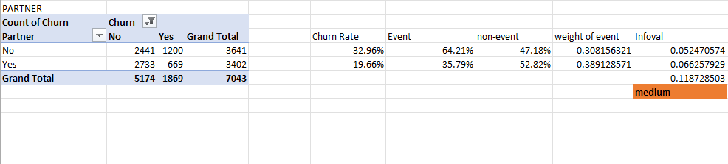
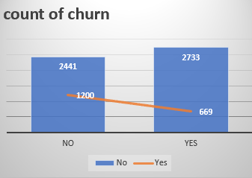
Interpretation – Medium Prediction
-This variable shows a moderate relationship with customer churn.
-The Information Value falls in the medium range, which means it provides useful information about churn behavior but cannot strongly predict churn on its own.
-Such variables help in understanding customer trends and become more effective when combined with strong predictors.
-They support decision-making but should not be used as the only factor for churn prediction.
-Information Value in medium range (0.1 – 0.3)

Slide 7
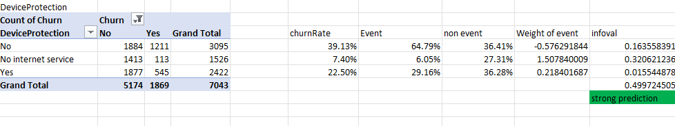
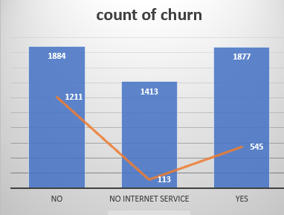
Interpretation – Strong Prediction
-This variable shows a strong influence on customer churn.
-The high Information Value indicates a clear separation between customers who churned and those who stayed.
-This means the variable is highly reliable for predicting churn and should be given priority while building churn models or designing retention strategies.
-IV is high (0.3 – 0.5)

Slide 8
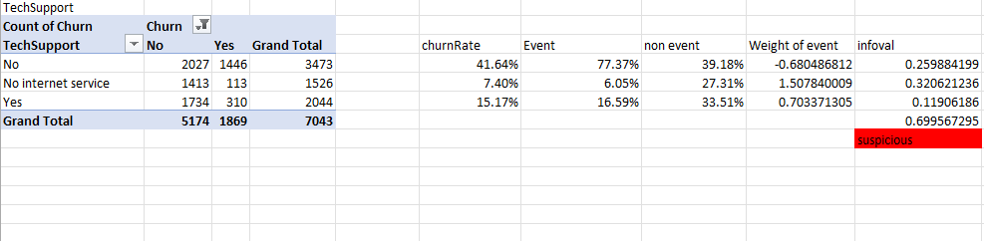
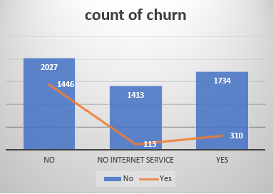
Interpretation – Suspicious Prediction
-Although this variable shows a very high Information Value, it is classified as suspicious.
-Such high values may occur due to data imbalance, overfitting, or abnormal data distribution, rather than a true relationship with churn.
-These variables may appear powerful but can be misleading and may not perform well on new data. -Therefore, they should be validated carefully before use.
-IV is very high(>0.5)

Slide 9
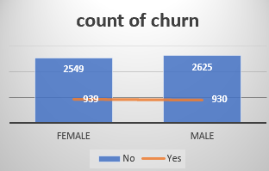
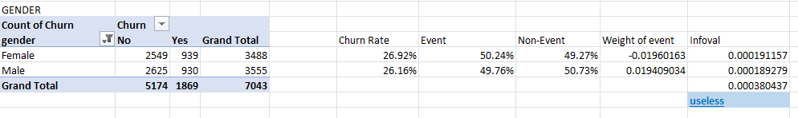
Why Useless Variables Are Not Considered?
-Variables classified as useless have a very low Information Value, which means they provide little or no information about customer churn.
-These variables do not help in differentiating between customers who churn and those who stay.
-Including such variables can increase complexity without improving accuracy and may negatively affect model performance.
-Therefore, useless variables are excluded to keep the churn analysis efficient, accurate, and meaningful.
-very low IV (< 0.02)

Slide 10
THANK YOU

